Slide 1
Major Topics in Artificial Intelligence

Slide 2
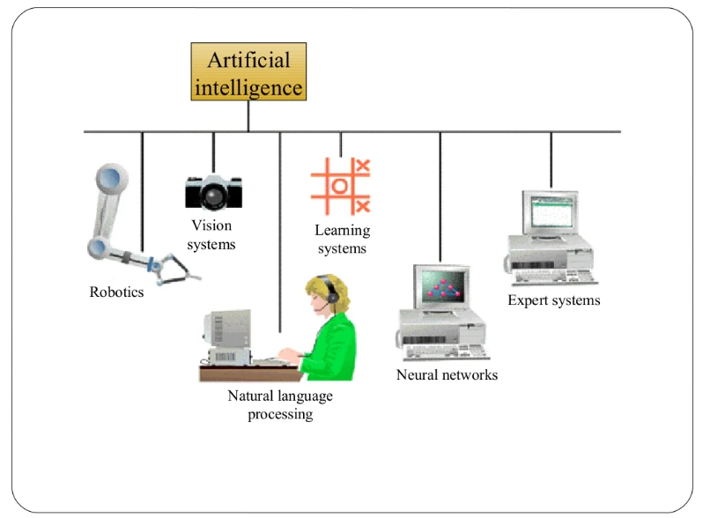
Components of AI

Slide 3
Learning Systems
Learning systems in AI refer to algorithms and methodologies that enable artificial intelligence systems to acquire knowledge, improve performance, and adapt to new situations over time
These systems aim to simulate or replicate human-like learning processes, allowing AI to become more intelligent and capable of handling complex tasks.

Slide 4
Types of learning systems in AI
Supervised Learning: AI model is trained on a labeled dataset, where each input is associated with the correct output.
The model learns to make predictions by generalizing from the provided examples.
Examples include image classification and language translation.
Unsupervised Learning: Training an AI model on an unlabeled dataset, with the goal of discovering patterns, structures, or relationships within the data.
Clustering and dimensionality reduction are common tasks in unsupervised learning.

Slide 5
Types of learning systems in AI
Semi-Supervised Learning: This approach combines elements of both supervised and unsupervised learning.
A small amount of labeled data is used along with a larger amount of unlabeled data to improve the learning process.
Reinforcement Learning: An AI agent interacts with an environment and learns to take actions that maximize a reward signal.
The agent learns through trial and error, refining its behavior over time.
This type of learning is well-suited for tasks involving decision-making and sequential actions, such as game playing and robotics.

Slide 6
Types of learning systems in AI
Transfer Learning: Transfer learning involves pre-training a model on one task and then fine-tuning it for a different but related task.
This approach leverages knowledge gained from one task to improve performance on another, often with limited labeled data for the target task.
Online Learning: Online learning, or incremental learning, involves updating an AI model continuously as new data becomes available.
This approach is useful for scenarios where data arrives in streams or batches.

Slide 7
Types of learning systems in AI
Evolutionary Algorithms: These algorithms are inspired by natural evolution
Evolving a population of candidate solutions over multiple generations to find the best solution to a problem.
They are often used in optimization tasks.
Cognitive Architectures: These systems attempt to replicate human-like cognitive processes and reasoning.
They often involve symbolic reasoning and knowledge representation.
Neuroevolution: This combines neural networks and evolutionary algorithms to evolve neural network architectures and weights for various tasks

Slide 8
Neural Networks
Computational models inspired by the structure and functioning of the human brain, designed to process and analyze complex patterns in data.
Neural networks consist of interconnected nodes (neurons) organized in layers, each layer contributing to the computation and transformation of data.
Neural networks are used for various tasks, including image and speech recognition, natural language processing, and more.

Slide 9
Key components of Neural Networks
Neuron (Node): Neurons are the basic computational units in a neural network. Each neuron takes input, performs a weighted sum of the inputs, applies an activation function, and produces an output.
Layers: Neural networks consist of layers of neurons. Common types of layers include:
Input Layer: Receives the initial data or features.
Hidden Layers: Intermediate layers between the input and output layers where computations occur.
Output Layer: Produces the final prediction or output.
Weights and Biases: Neurons in a neural network are connected by weighted connections, and each connection has an associated weight. Biases are added to the weighted sum before applying the activation function.

Slide 10
Key components of Neural Networks
Activation Function: The activation function determines whether a neuron "fires" based on the weighted sum of inputs. Common activation functions include sigmoid, tanh, and rectified linear unit (ReLU).
Feedforward Propagation: In feedforward propagation, data flows from the input layer through the hidden layers to the output layer. Each neuron's output contributes to the next layer's input.
Backpropagation: Backpropagation is a training technique that adjusts the weights of the connections to minimize the difference between predicted outputs and actual outputs. It involves calculating gradients and updating weights using optimization algorithms like gradient descent.

Slide 11
Key components of Neural Networks
Training Data: Neural networks require labeled training data to learn patterns and relationships in the data. The network adjusts its weights during training to improve its predictions.
Loss Function (Cost Function): The loss function measures the difference between predicted outputs and actual outputs. It quantifies the network's performance and guides the learning process.
Optimization Algorithms: These algorithms, such as gradient descent, are used to update weights during training to minimize the loss function.
Deep Learning: Deep learning involves training deep neural networks with many hidden layers. It has been particularly successful in complex tasks like image and speech recognition.

Slide 12
Computer Vision
Computer vision is a multidisciplinary field of study that focuses on enabling machines to interpret and understand visual information from the world around them, much like humans do.
It involves developing algorithms and techniques that allow computers to extract meaningful insights from images and videos, enabling them to perceive and interact with their environment.
Computer vision is a fundamental technology in various applications, including image analysis, object recognition, and scene understanding.

Slide 13
Key components of computer vision
Image Processing: Image processing involves manipulating and enhancing digital images to improve their quality, extract relevant features, and reduce noise. Techniques include filtering, edge detection, and image enhancement.
Feature Extraction: Computer vision algorithms often extract distinctive features from images to represent objects or patterns. These features can include edges, corners, textures, and more.
Object Detection and Recognition: Algorithms in this area identify and locate objects within images or videos. Object detection involves determining the presence and position of objects, while recognition involves categorizing objects into specific classes.
Image Classification: This is the process of assigning a label or category to an entire image. Deep learning models, such as convolutional neural networks (CNNs), have achieved remarkable success in image classification tasks.

Slide 14
Key components of computer vision
Semantic Segmentation: Semantic segmentation assigns a class label to each pixel in an image, enabling detailed understanding of object boundaries and regions.
Scene Understanding: This involves comprehending the relationships between objects and their context within a scene. It goes beyond object detection to capture the broader scene context.
Motion Analysis: Computer vision algorithms can track and analyze motion within images or videos, enabling applications like action recognition, optical flow estimation, and more.

Slide 15
Key components of computer vision
Face Recognition: Specialized techniques are used to identify and verify individuals based on facial features, often used in security and authentication systems.
Medical Imaging: Computer vision is applied in medical fields for tasks such as diagnosing diseases from medical images (e.g., X-rays, MRIs) and assisting in surgical procedures.
Autonomous Vehicles: Computer vision plays a critical role in enabling self-driving cars to perceive and navigate their surroundings, detect obstacles, and make real-time driving decisions.

Slide 16
Robotics
Robotics is an interdisciplinary field that involves the design, construction, operation, and use of robots.
Robots are machines or autonomous systems that are capable of performing tasks with varying degrees of autonomy.
Robotics integrates principles from diverse areas such as mechanical engineering, electronics, computer science, artificial intelligence, and control systems to create intelligent and adaptable machines that can interact with and manipulate their environments.

Slide 17
Key aspects of Robotics
Robot Design and Mechanics: This involves creating the physical structure of robots, including their mechanical components, sensors, actuators, and interfaces. Robot design varies depending on the intended application, such as industrial automation, healthcare, or exploration.
Sensors and Perception: Robots use various sensors (e.g., cameras, lidar, radar, tactile sensors) to gather information about their environment. Perception algorithms process sensor data to understand the robot's surroundings and make informed decisions.
Actuators and Movement: Actuators (e.g., motors, servos) allow robots to move and interact with their environment. Robotic movement can range from simple locomotion to complex manipulation.

Slide 18
Key aspects of Robotics
Control Systems: Control systems enable robots to execute tasks with precision and accuracy. These systems manage the robot's actuators based on sensory input and control algorithms.
Artificial Intelligence and Machine Learning: AI techniques, such as machine learning and deep learning, are used to enable robots to learn from data, make predictions, and adapt to changing situations.
Path Planning and Navigation: Robots need to plan optimal paths and navigate through complex environments. Path planning algorithms help robots avoid obstacles and reach their destinations efficiently.
Autonomous Operation: Autonomous robots can perform tasks without continuous human intervention. This capability is essential for applications like self-driving cars and drones.

Slide 19
Robotics applications
Industrial Automation: Robots perform tasks such as welding, assembly, and quality control in manufacturing processes.
Medical Robotics: Surgical robots assist surgeons in performing minimally invasive procedures with high precision.
Agricultural Robotics: Robots can automate tasks like planting, harvesting, and monitoring crops.
Space Exploration: Robots like rovers and landers are used to explore distant planets and moons.
Service Robotics: Robots are used in various service industries, such as healthcare, hospitality, and customer service.

